Slide 2
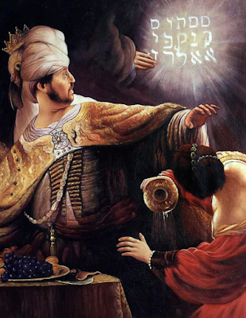
Daniel 5:17-28
Daniel to Belshazzar around 556 B.C. concerning his vision of a HAND writing on the wall of his palace

Slide 3
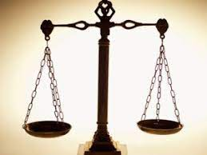
“weighed in the balance, and found wanting”

Slide 4
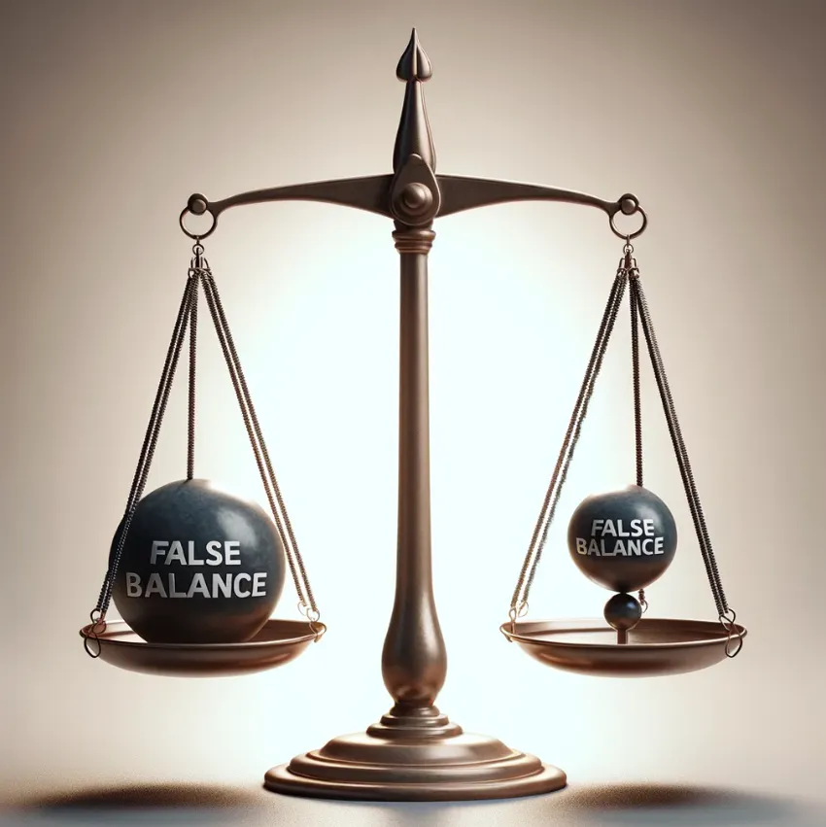
False balances
Compare themselves with others!
“I’m no worse than he is!”
“I’m better than they are!”

Slide 5

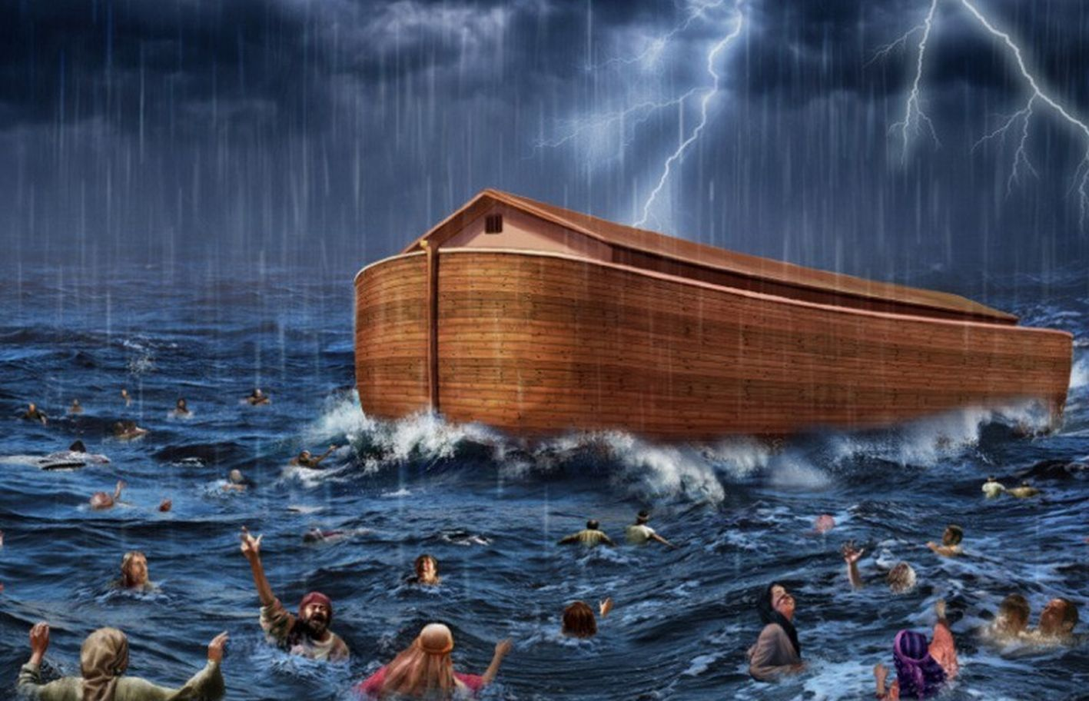
NOAH’S TIME

Slide 6
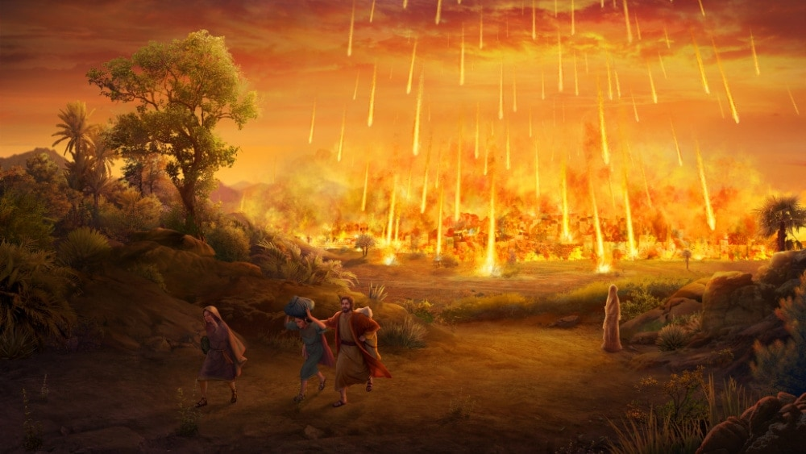
SODOM AND GOMORRAH

Slide 7
2 CORINTHIANS 10:12
"For we dare not class ourselves or compare ourselves with those who commend themselves. But they, measuring themselves by themselves, and comparing themselves among themselves, are not wise."

Slide 8
False balances
Their Own Opinion!
“Well, I don’t see anything wrong with this or that!”
“It seems alright to me!”
“I just don’t like it!”

Slide 9
Jeremiah 17:9
"The heart is more deceitful than all else and is desperately sick; Who can understand it?“
We will convince ourselves that we are RIGHT!

Slide 10
False balances
What others think! Galatians 1:10
1 Corinthians 1:18-21
“will destroy the wisdom of the wise, and bring to nothing the understanding of the prudent."

Slide 11
The scale of divine truth
Hebrews 4:12

Slide 12
Spiritual character
1 Corinthians 3:1-3 – Envy, Strife & Divisions signs of CARNALITY
And carnality show a lack of SPIRITUAL MATURITY!
Which is the same a “walking after the manner of mere men!”

Slide 13
Spiritual character
1 Corinthians 3:1-3 – Envy, Strife & Divisions signs of CARNALITY
And carnality show a lack of SPIRITUAL MATURITY!
Which is the same a “walking after the manner of mere men!”
Are you “weighed in the balances and found wanting?”

Slide 14
How about our principles?
Matthew 22:35-40
FIRST: Love God With All We Have!
Implicit Trust in the Lord! Psalm 125:1; 37:4; John 14:15
SECOND: Love Or Fellow Man- Mark 12:31; 1 Peter 1:22; 3:8,9
Are any of us “weighed in the balances and found wanting here?”

Slide 15
How about our attitudes?
Hebrews 6:17-19 – “This {hope} we have as an anchor of the soul”
Clothed with humility – 1 Peter 5:5
Patience - James 1:2-4 “testing of your faith produces patience”
Are any of us “weighed in the balances and found wanting here?”

Slide 16
How about our experience?
2 Peter 3:17,18 “but grow in the grace and knowledge of our Lord and Savior Jesus Christ.”
Conscious Effort on Our Part!
Growth will bring Strength
Are any of us “weighed in the balances and found wanting here?”

Slide 17
How about our usefulness?
1 Corinthians 15:58 “abounding in the work of the Lord”
ALL of our abilities should be aimed to further the Lord's work!
Abounding: “to superabound (in quantity or quality), be in excess,…”
Are any of us “weighed in the balances and found wanting here?”

Slide 18
The balances of divine truth
2 Corinthians 13:5

Slide 19
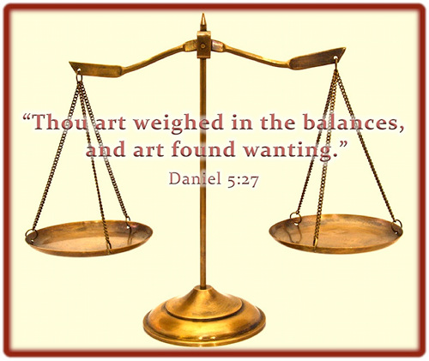
Now is the time to do something about it!
In the last day, it will be too late!

Slide 20
How do you measure up today?
Outside of Christ?
Having strayed from the path?
W
A
N
T
I
N
G
Why not take the steps necessary to change that this hour?

